Slide 1

Project 1

Slide 2
Objectives
Demonstrate skin cancer is a crucial concern in Australia
Identify all the risk factors contributing to skin cancer
Understanding the correlation of different risk factors. Can we prevent skin cancer

Slide 3
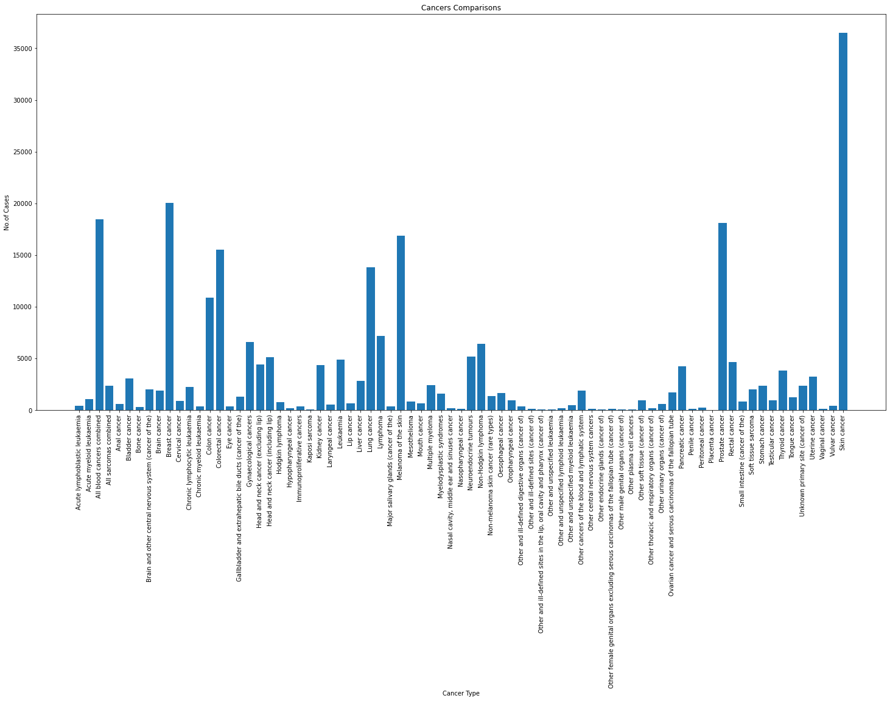
Different types of cancer in Australia

Slide 4
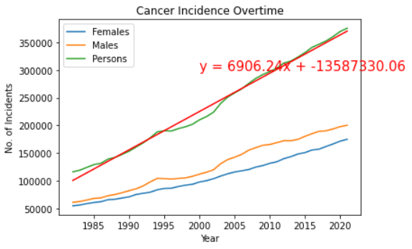
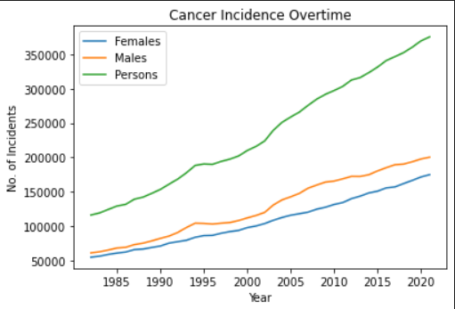
Cancer Incidence overtime

Slide 5
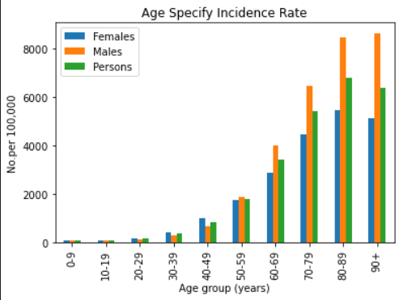
ASR Incidence vs Age group

Slide 6
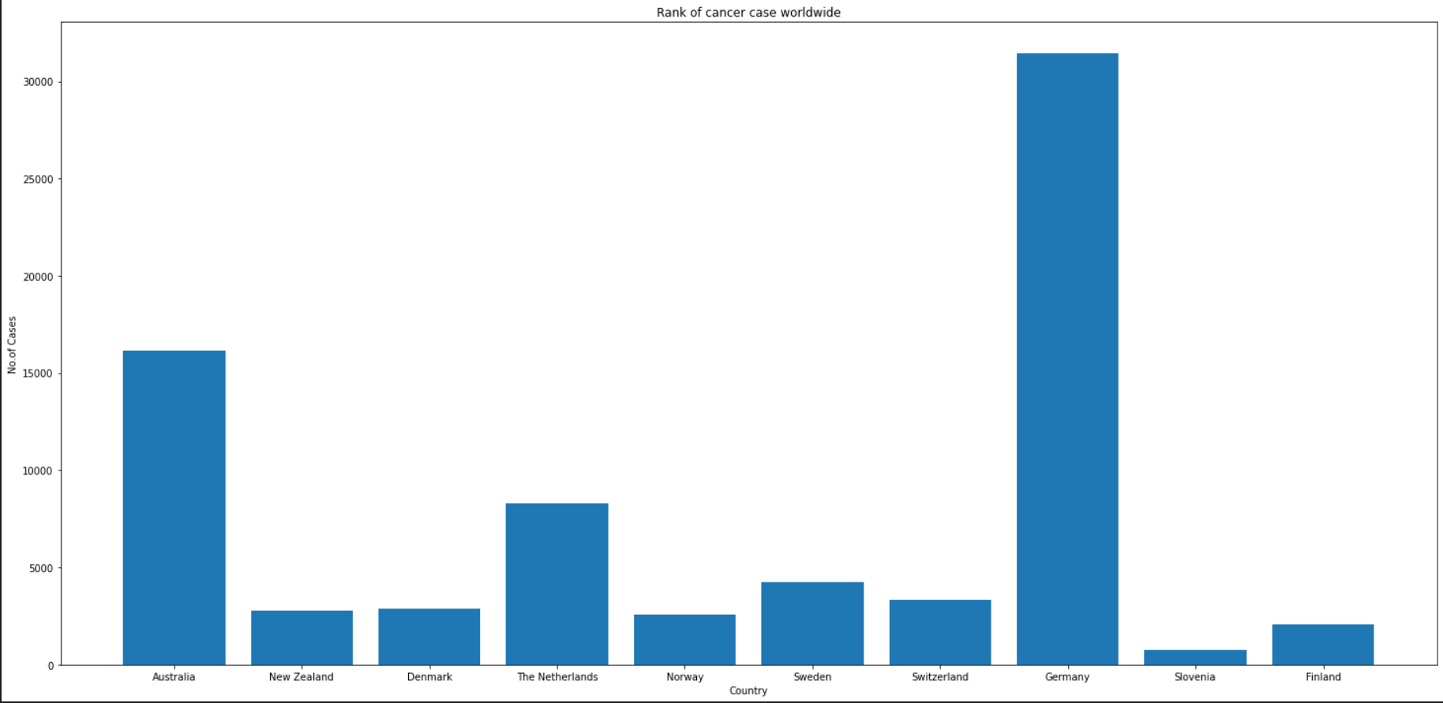
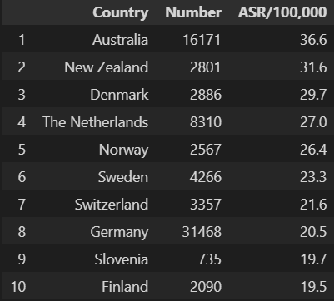
Australia vs Worldwide

Slide 7
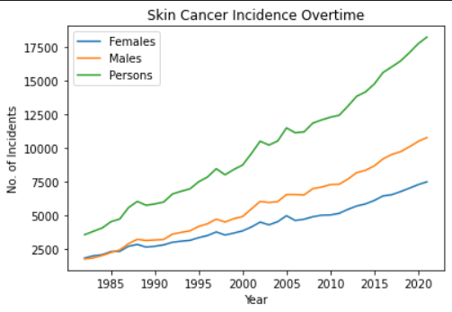
Skin Cancer Incidence overtime

Slide 8
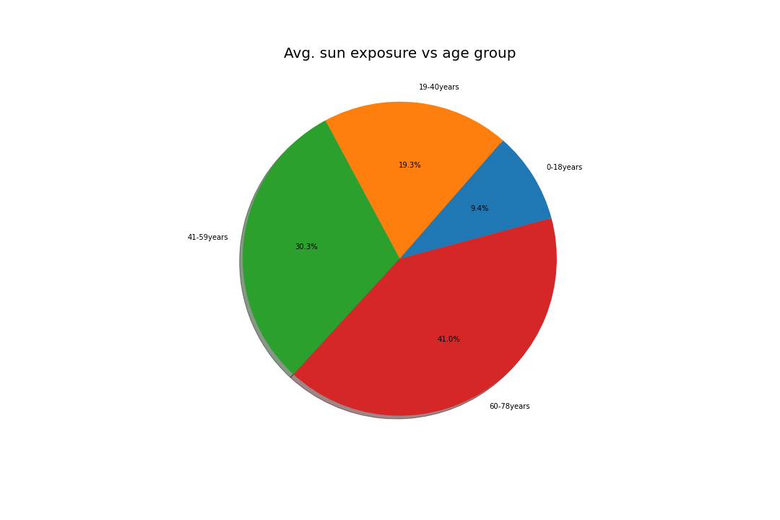
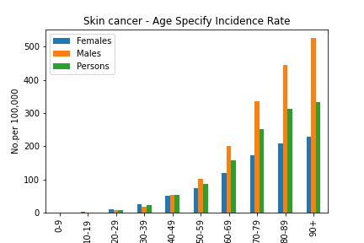

Slide 9
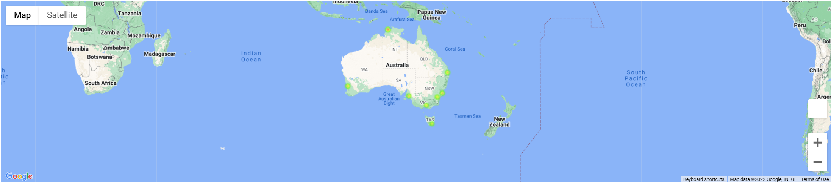
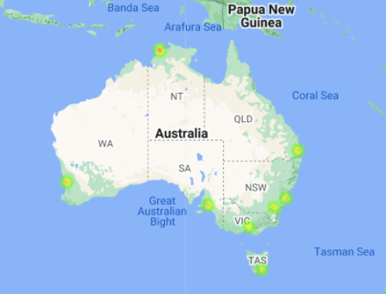
Australia major city avg.UV index

